Slide 1

Complexity Matching of Auditory Stimuli & EEG Responses
Adolfo G. Ramirez-Aristizabal

Slide 2

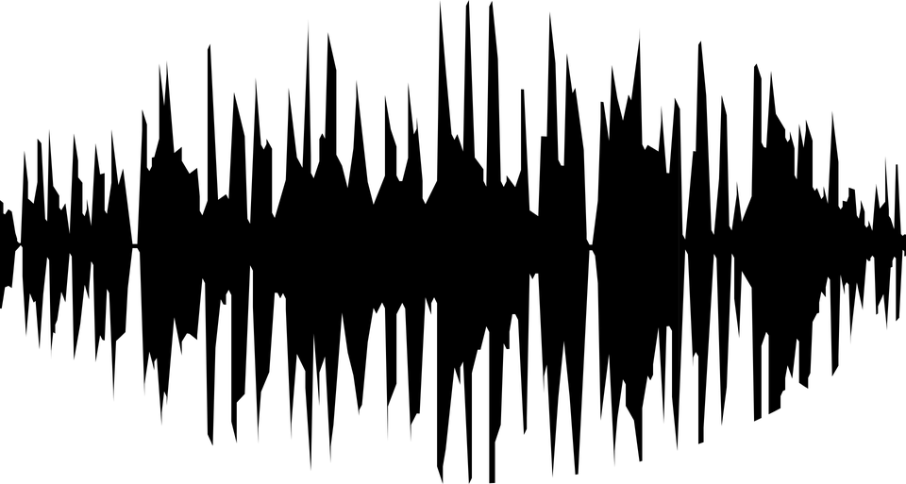
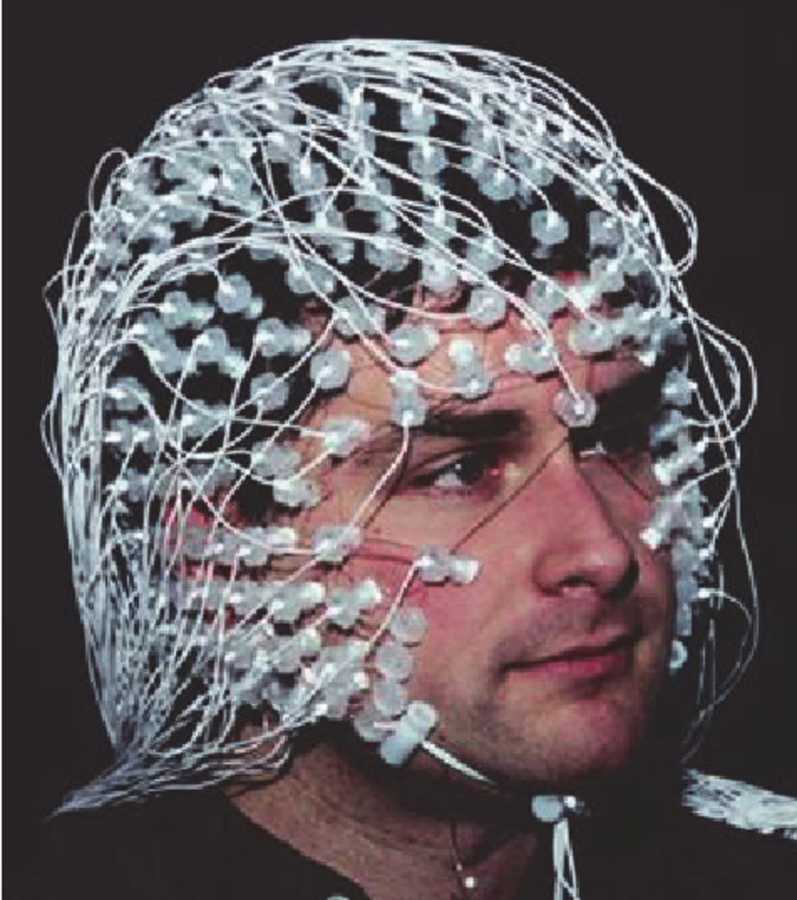
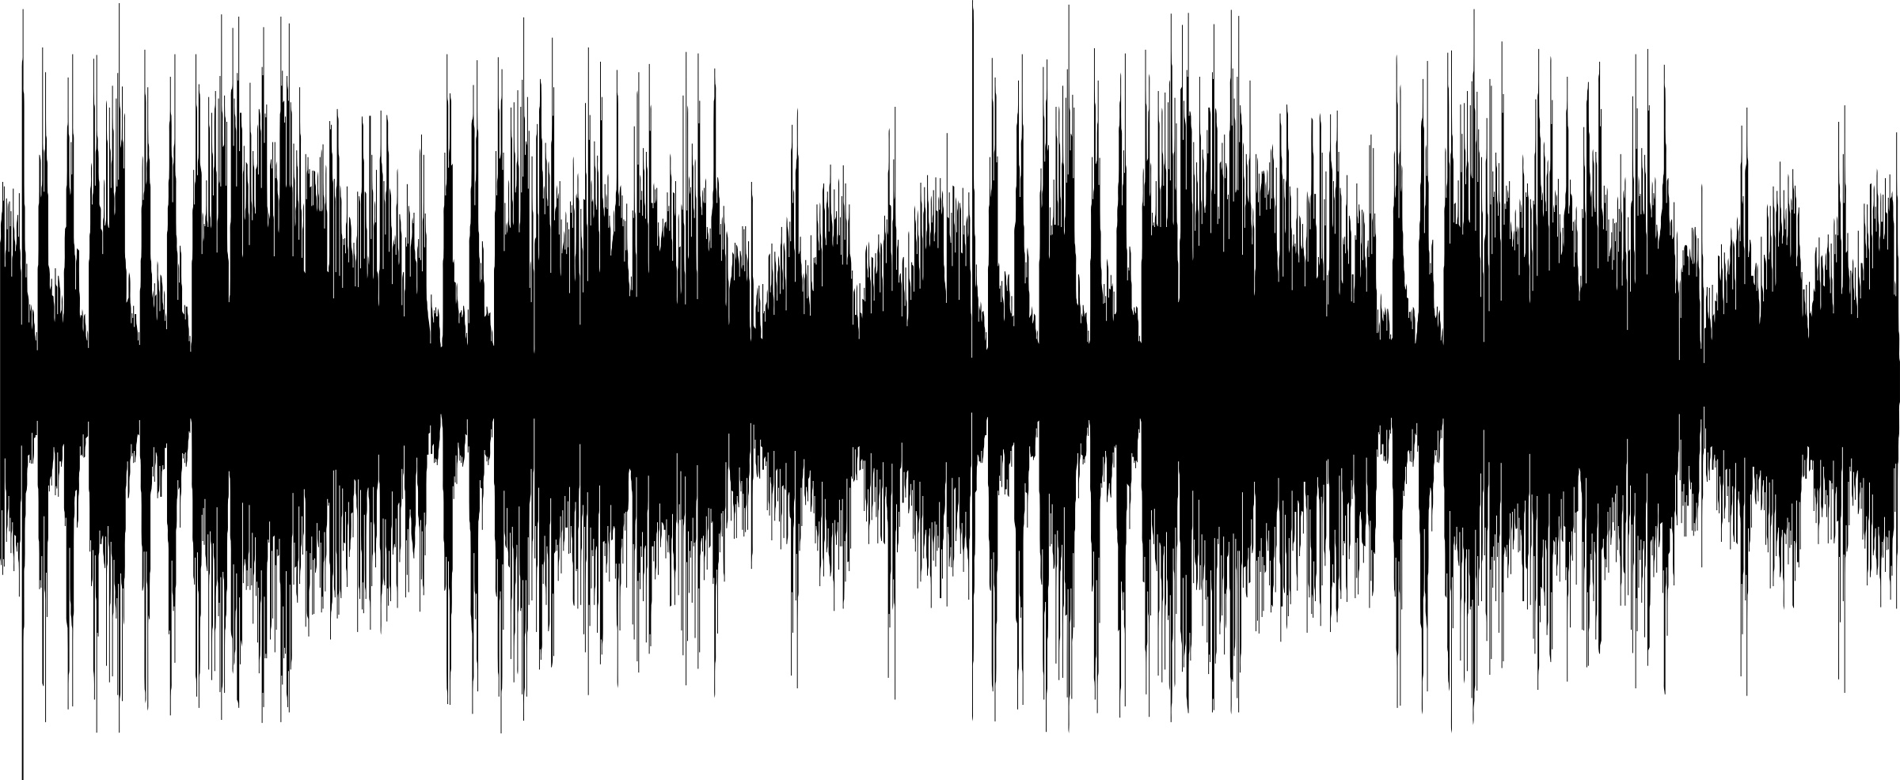
Auditory Stimuli
Brain Response

Slide 3
Hypothesis
Auditory Stimuli
Brain Response

Slide 4
Why do we think this?
Neural Entrainment
Stimuli rhythm (simple to complex) shows modulation in brain responses
Slower rhythms demonstrate slower corresponding brain responses and same with faster rhythms (Musacchia, Large, & Schroeder, 2014)
Pitch variability in prediction/error tasks modulate beta band (Chang, Bosnyak, & Trainor, 2016)

Slide 5
Why do we think this?
Abney et al., (2014)
Evidence for complexity matching in friendly dyadic conversations
Schneider et al., (Under Review)
Hierarchical temporal structure of bilingual dyads show matching effects
Ding & Poeppel et al., (2016)
Evidence for cortical tracking at distinct linguistic hierarchies
Di Liberto et al., (2015)
Phonemic units in natural speech (~155 secs) tracked by lower frequencies

Slide 6
Why do we think this?
Abney et al., (2014)
Evidence for complexity matching in friendly dyadic conversations
Schneider et al., (Under Review)
Hierarchical temporal structure of bilingual dyads show matching effects
Ding & Poeppel et al., (2016)
Evidence for cortical tracking at distinct linguistic hierarchies

Slide 7
Hierarchical Temporal Structure of Sounds
Kello et al., (2017)
Perceptually distinct sounds can share underlying HTS associations
Maybe the brain can pick up on these associations; reflected in neural oscillations

Slide 8
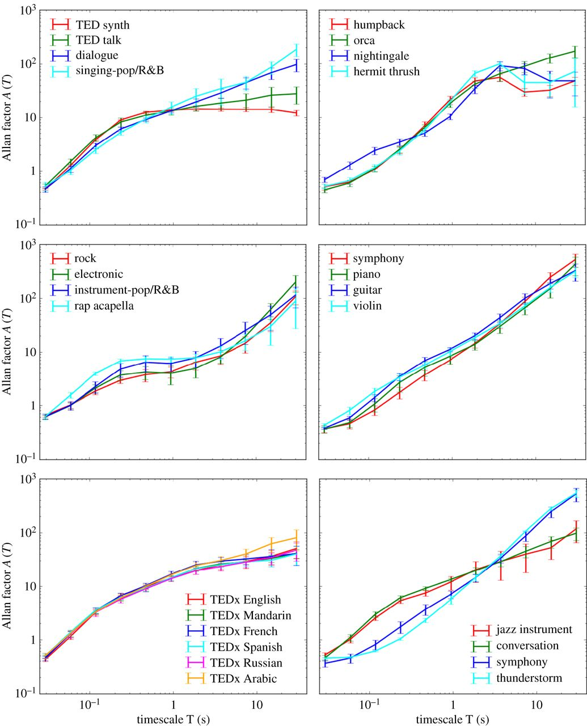
Hierarchical Temporal Structure of Sounds

Slide 9
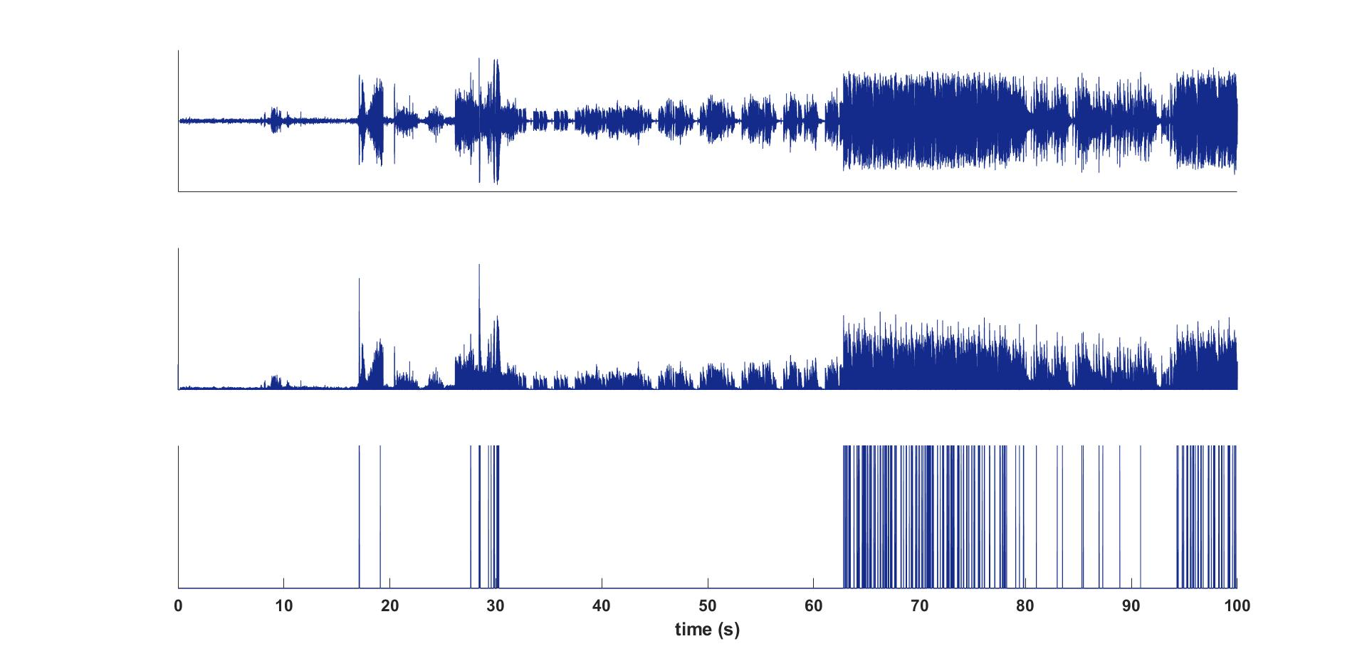
Methods

Slide 10
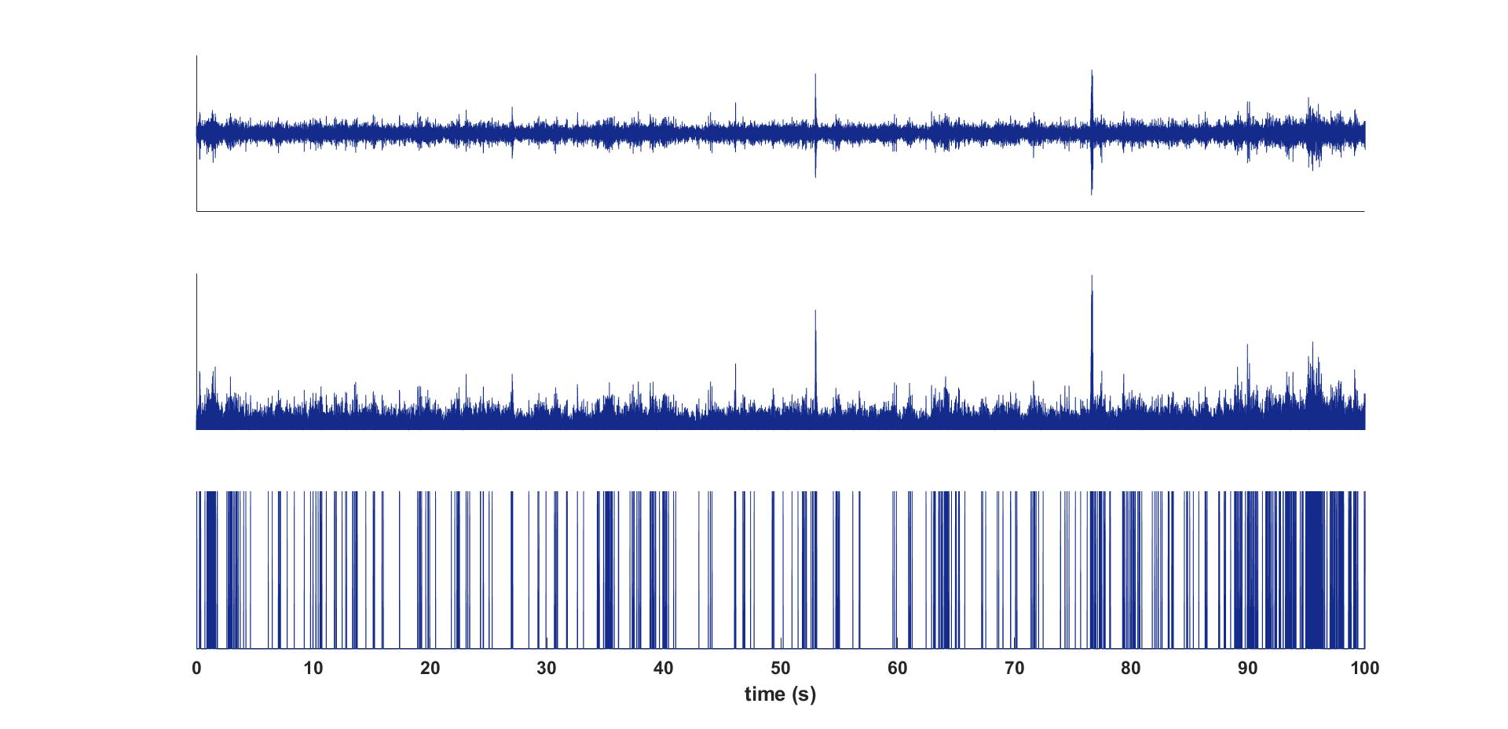
Methods

Slide 11
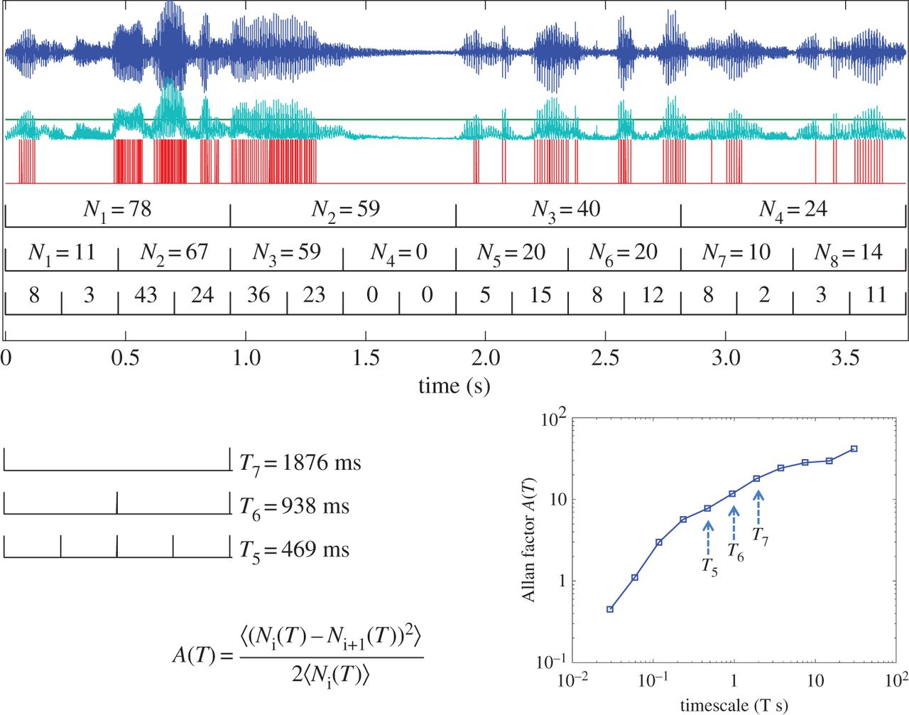
Methods

Slide 12
Methods
N = 11
Conditions = [EDM, Hermit-Thrush, Sine Ted, Symph1, Symph2, Ted Talk]
Stimuli Lengths: 4:20-4:42 mins
EEG Recording Lengths: 4:20 mins
Audio and EEG Sample Rates: 2048 Hz
ICA component sample rates: 1024 Hz
ANT EEG system with 32 channel Waveguard electrode cap
EEG processed using EEGLab

Slide 13
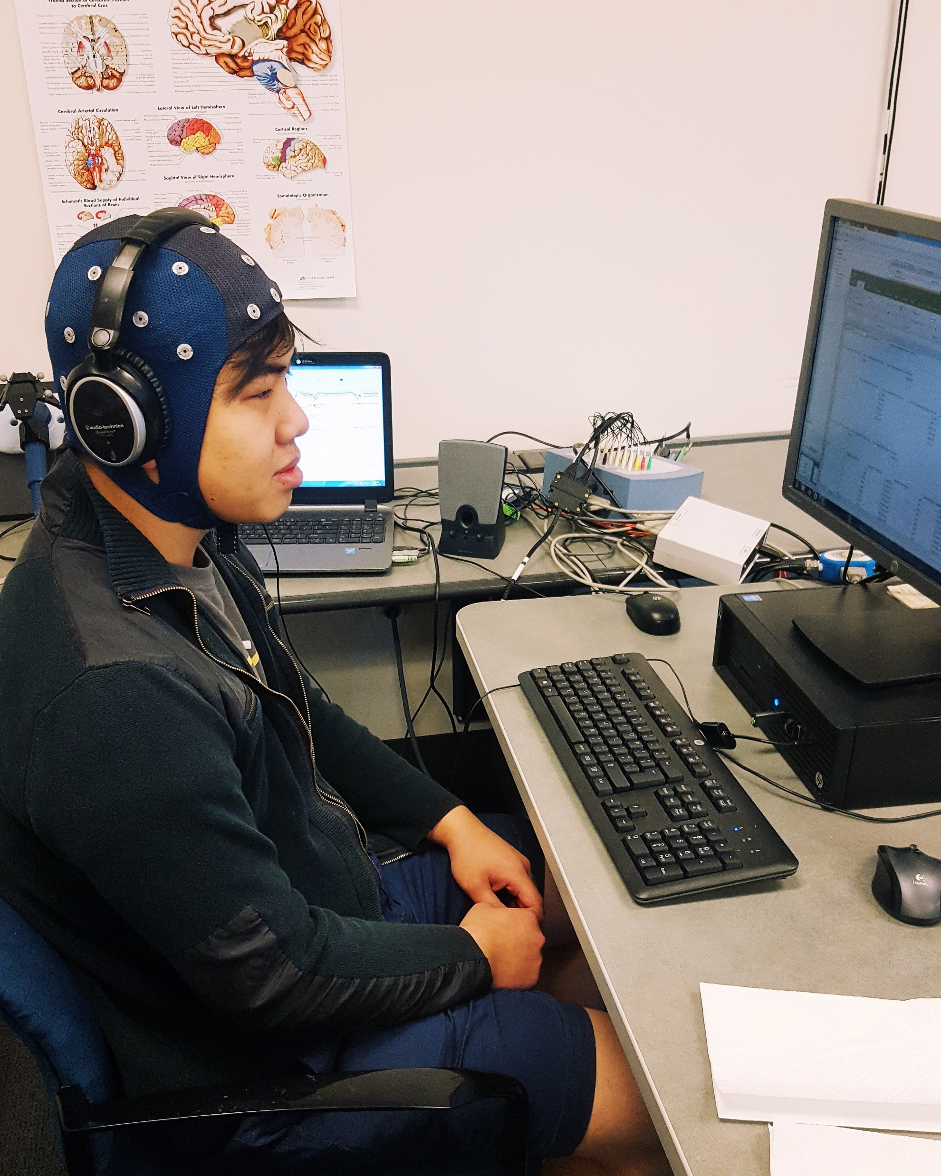
Processing and Cleaning
EEG cleaned to remove 60 Hz line noise, removes 60 Hz sinusoids caused by A/C current
Probability function used for bad channel rejection
Data used had a .1 Hz High Pass filter to remove drift

Slide 14
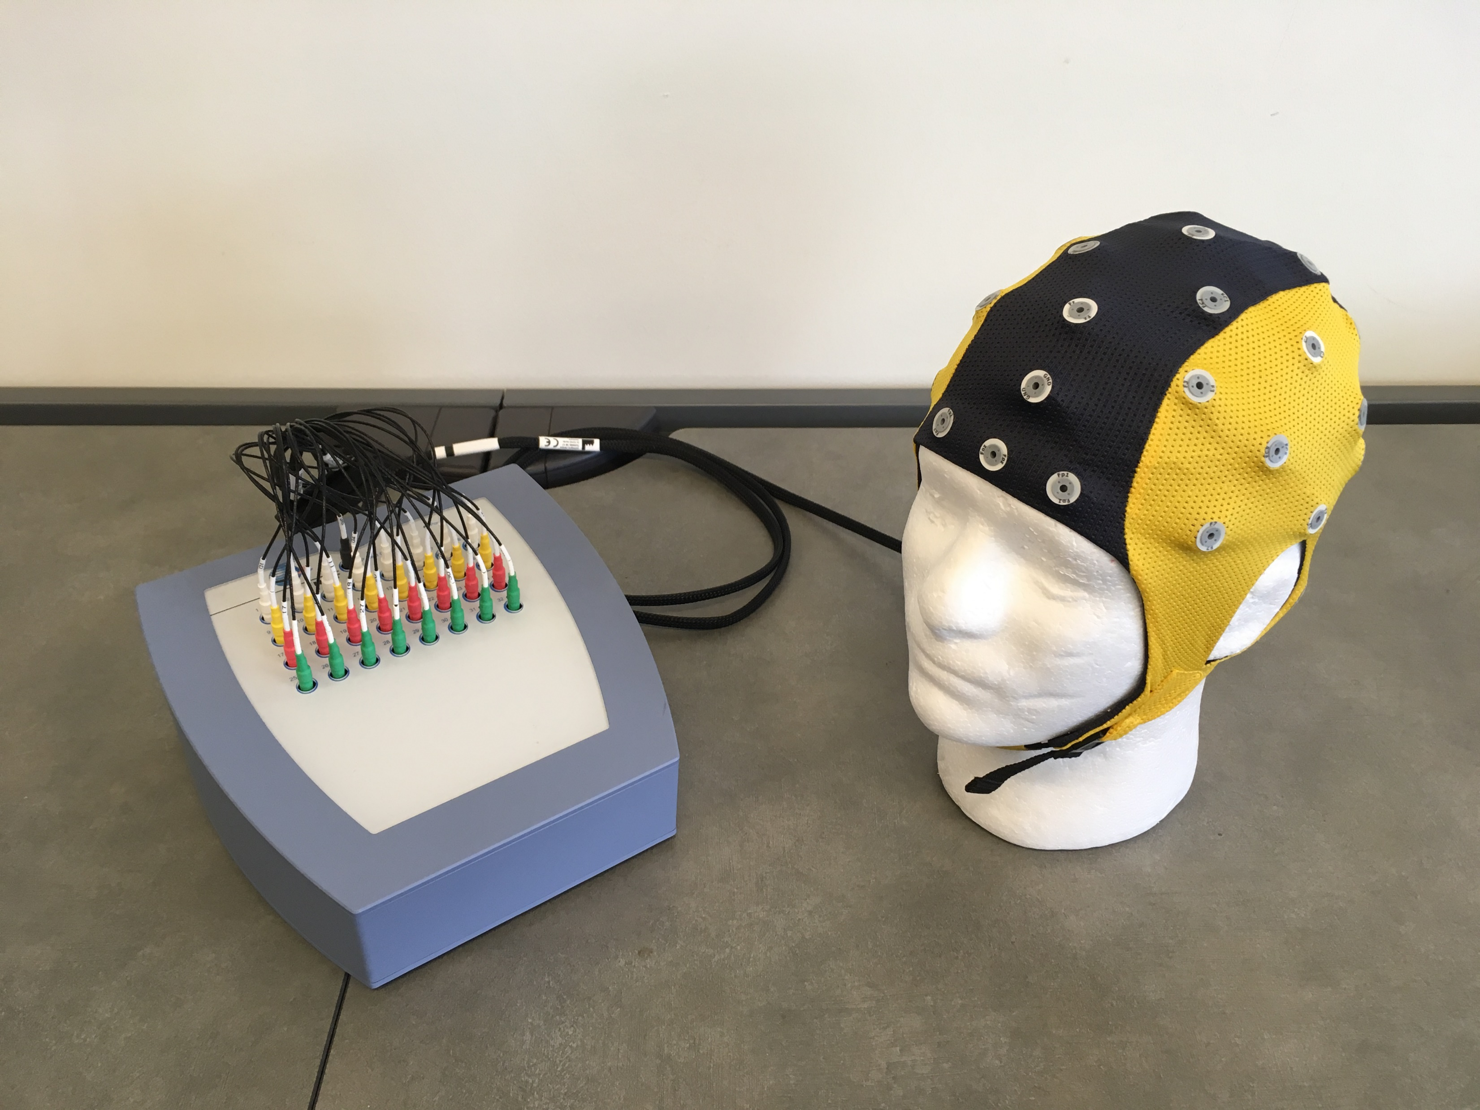
Results

Slide 15
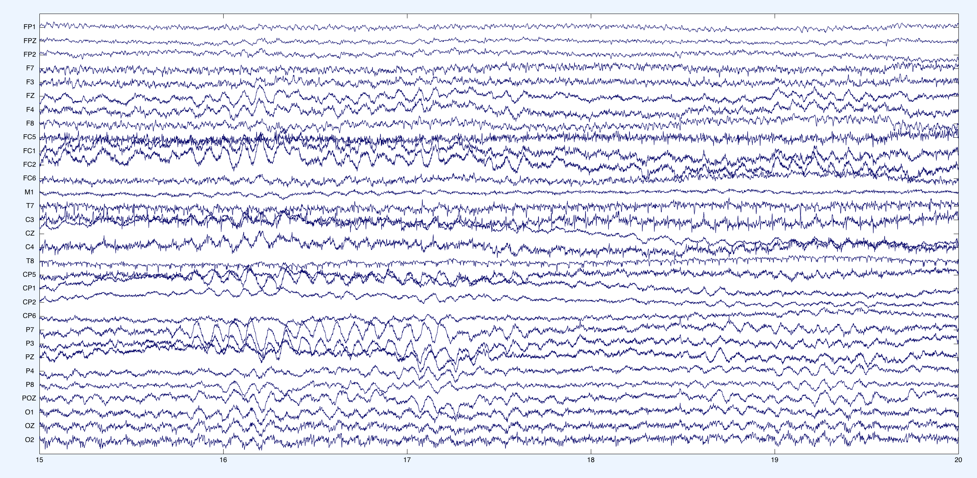
Results

Slide 16
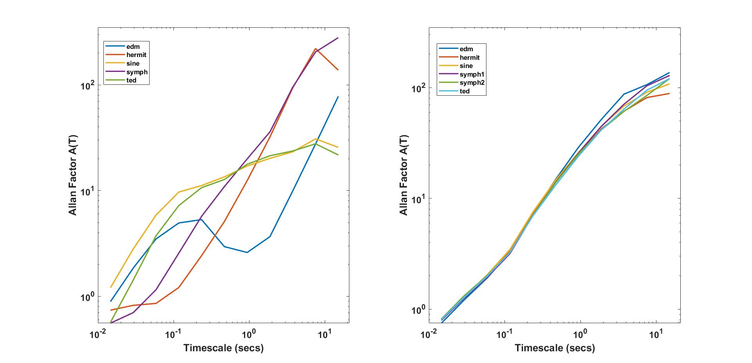
Results

Slide 17
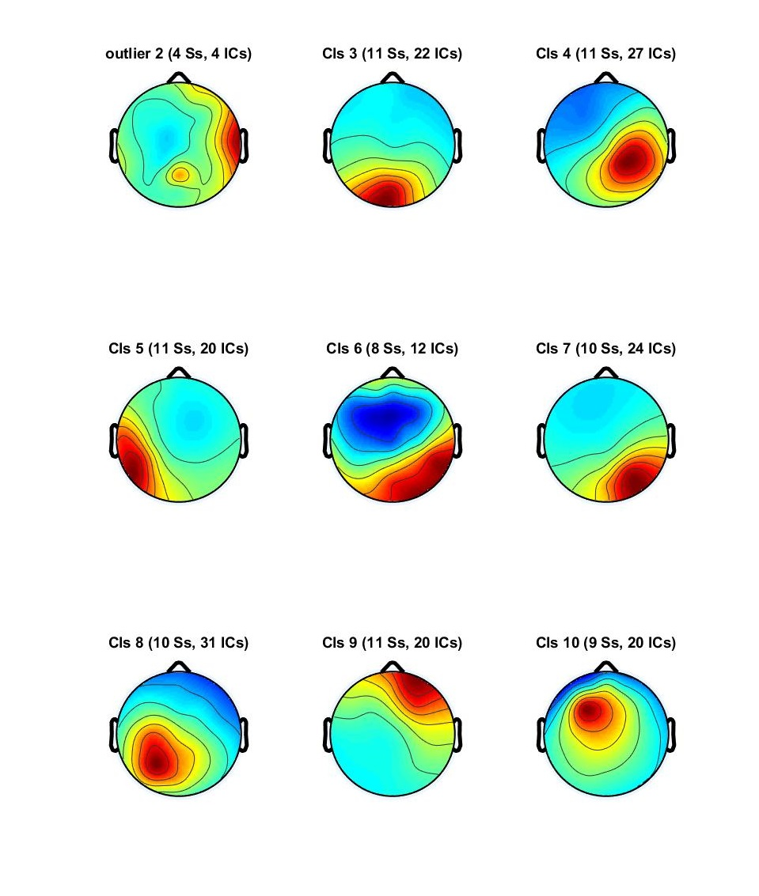
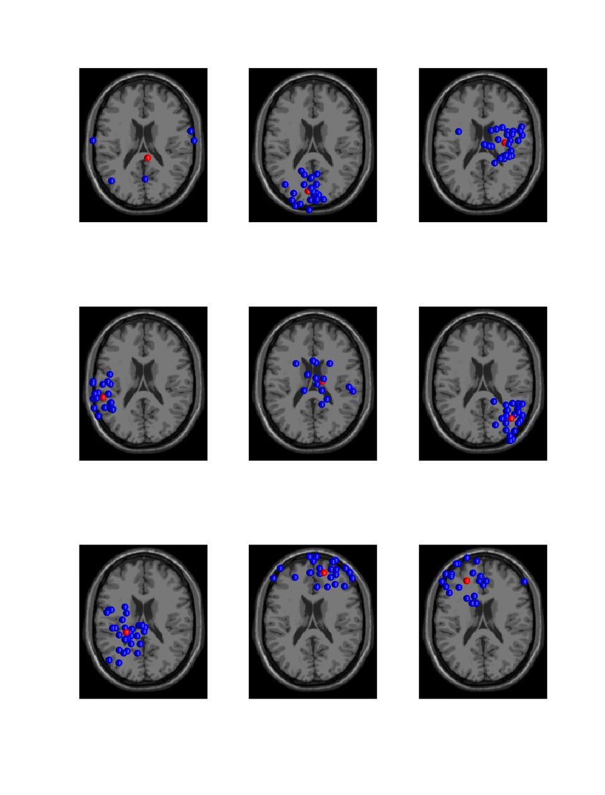
Results

Slide 18
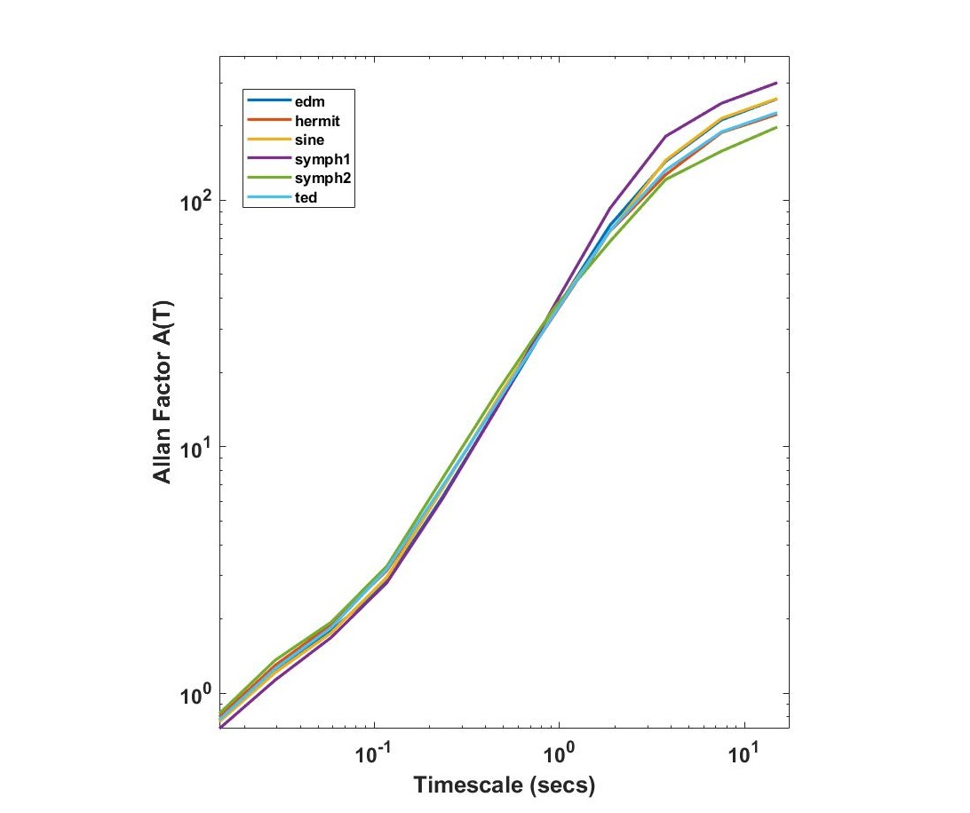
Results

Slide 19
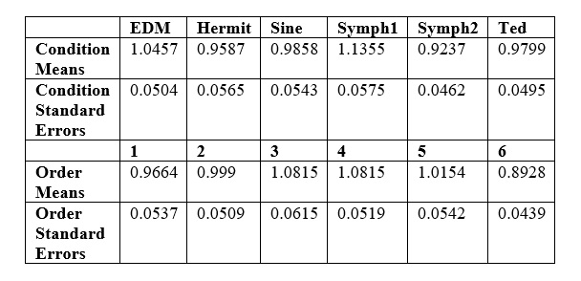
Results

Slide 20
Results
Two-way ANOVA
Linear Slopes ~ Stimuli*Cluster + Error(Participants/Stimuli*Cluster)
P = 0.0633
Tukey Honest Significant Difference test
Symphony1-Symphony2
P = 0.0471

Slide 21
Auditory Stimuli
Brain Response

Slide 22
Discussion
Orthogonal components = 1/f
ICA components = 1/f
Auditory, Occipital, Sensory-motor, Frontal regions = 1/f
Allegrini et al., 2009
-CM predictions
-Endogenous self sustaining oscillations are most sensitive to 1/f stimuli

Slide 23
Discussion
Neural Modulation affected by prediction/error and familiarity
-beta band is most sensitive
-15-25 Hz
Dynamic Attending Theory
-Adherence to stimuli’s (Endogenous neural (Dynamic allocation
temporal complexity = neural oscillations)* of attention)
Variability in modulation affected by novelty of stimuli
Repeated Presentations Experiment
Pseudo Entrainment on a larger scale

Slide 24
Discussion
The simple alternative explanation
-We didn’t find the proper way to extract the corresponding BR
EEG measurement
-low temporal/topographic resolution
-orthogonal & independent components from large regions
-activation summation of regions we should treat as separate

Slide 25
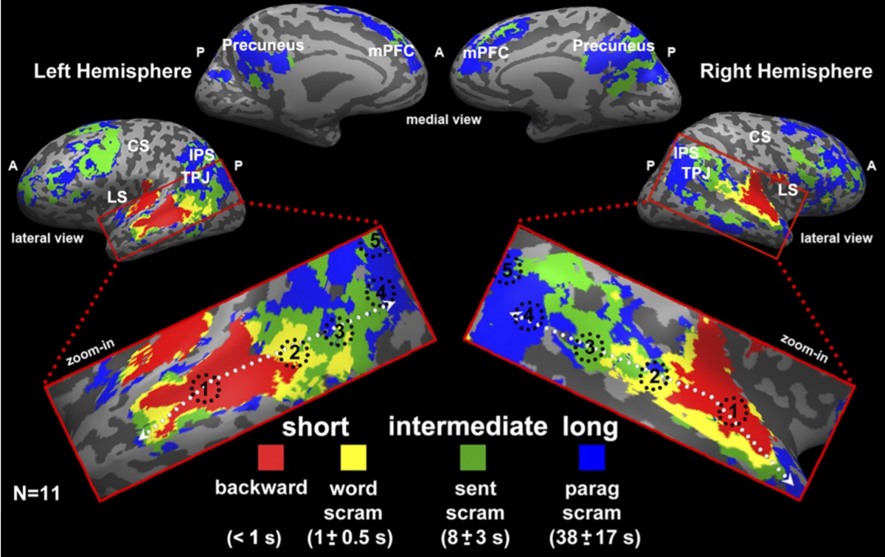
Discussion

Slide 26
Proposal
General Timescale Localization Model
-needs more fine grain testing hierarchical processing
-minor differences between speech and music, generalize for multiple auditory stimuli
1.GTLM guides peak amplitude selection for different timescales
2.If EEG, needs better topographic resolution
3.Event integration into one timeseries
4.AF analysis
5.CM analysis

Slide 27

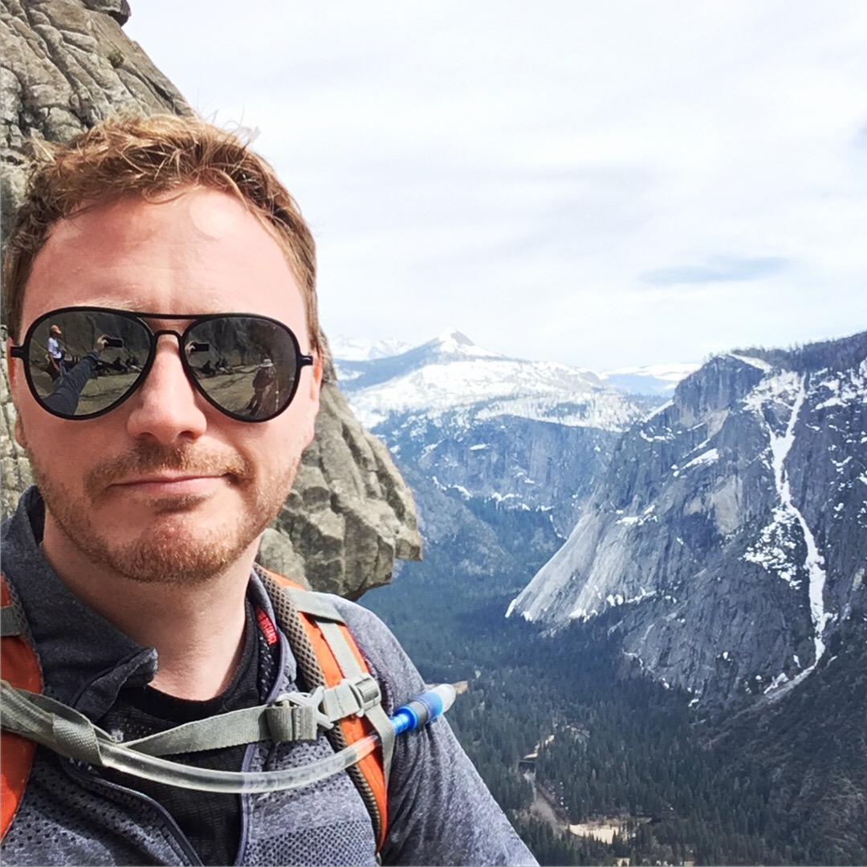

Acknowledgements
Adviser Collaborator Co-Adviser
Chris Kello
Daniel Comstock Ramesh Balasubramaniam
Research Assistants
Alejandra Santoyo Priscilla Chan

